Slide 1

Software Engineering Requirements Engineering
Slides for cse470 video lecture series produced by:
A.M.Esfar-E-Alam
Afrina Khatun
Dr.Muhammad Zavid Parvez

Slide 2

Requirements Engineering
Make me a software
What software?

Slide 3

Topics
What is requirements
Types of requirements
Requirements engineering processes
The overall requirements engineering process includes fourhigh-level requirements engineering sub-process
Requirements elicitation
Requirements analysis
Requirements validation
Requirements management

Slide 4

What is a requirements?
Requirements generally here is a contract of what are the things we are agreeing to make
It may range from a high-level abstract statement of a service or of a system constraint to a detailed functional specification.
This is inevitable as requirements may serve a dual function
May be the basis for a bid for a contract – therefore must be open to interpretation;
May be the basis for the contract itself – therefore must be defined in detail;
Both these statements may be called requirements.
This are the things you will deliver
Agreed!!

Slide 5

Functional and non-functional requirements
Functional requirements
Statements of services the system should provide, how the system should react to particular inputs and how the system should behave in particular situations. May state what the system should not do.
Non-functional requirements
Constraints on the services or functions offered by the system such as timing constraints, constraints on the development process, standards, etc. Often apply to the system as a whole rather than individual features or services.

Slide 6
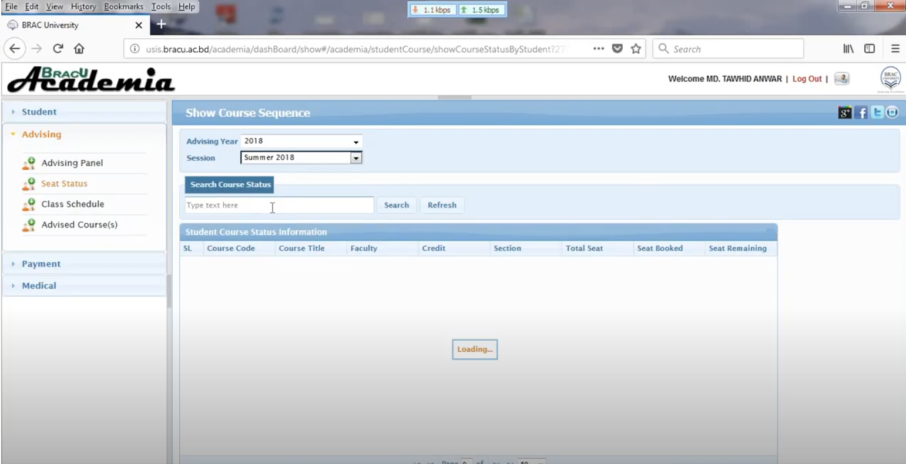
Example
Lets explain with an example first. Once we understand we can look into all aspects of functional and non functional requirements.
Lets say you are building a system like usis that can help BRAC University students to register into the courses.
So if asked what can be the functional and non functional requirements?
Functional requirements will be the features or the functionality it has and non functional property is the system property or the constraints it has.
Lets make it clearer by listing down some of its functional and non functional properties

Slide 7
Example
Functional
Non Functional
Student can add a course
Drop a course
See available seats
See the routine
Students will require password and student Id to log in
Faculty name and initials
etc
Log in system should be secured
It should be able to handle 500 request per minute so that it does not crash in peak times
It should be usable in pc, smartphones, phones and tabs
etc

Slide 8
Functional requirements
Describe functionality or system services.
Depend on the type of software, expected users and the type of system where the software is used.
Functional user requirements may be high-level statements of what the system should do.
Functional system requirements should describe the system services in detail.

Slide 9
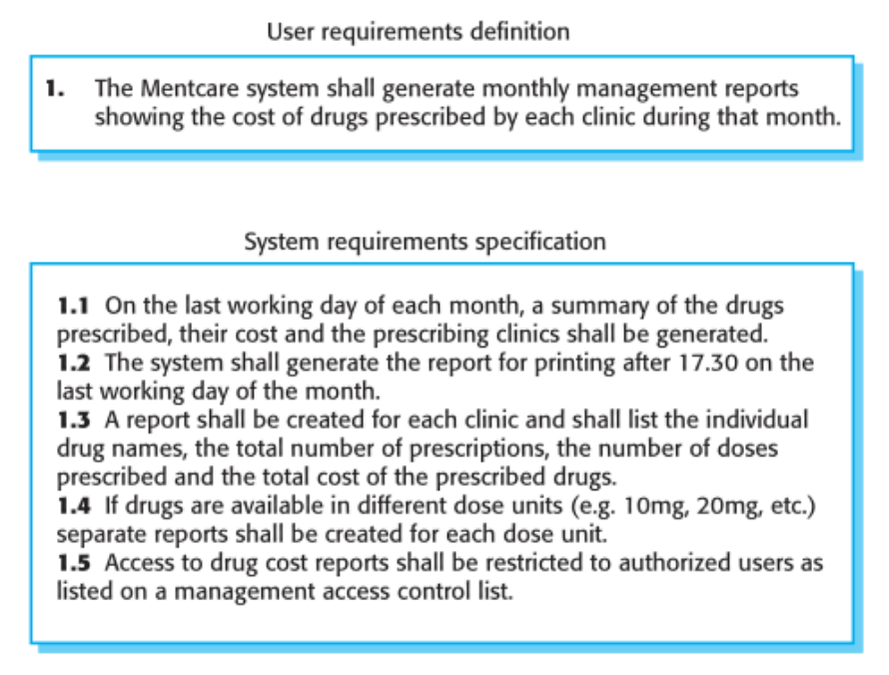

Slide 10
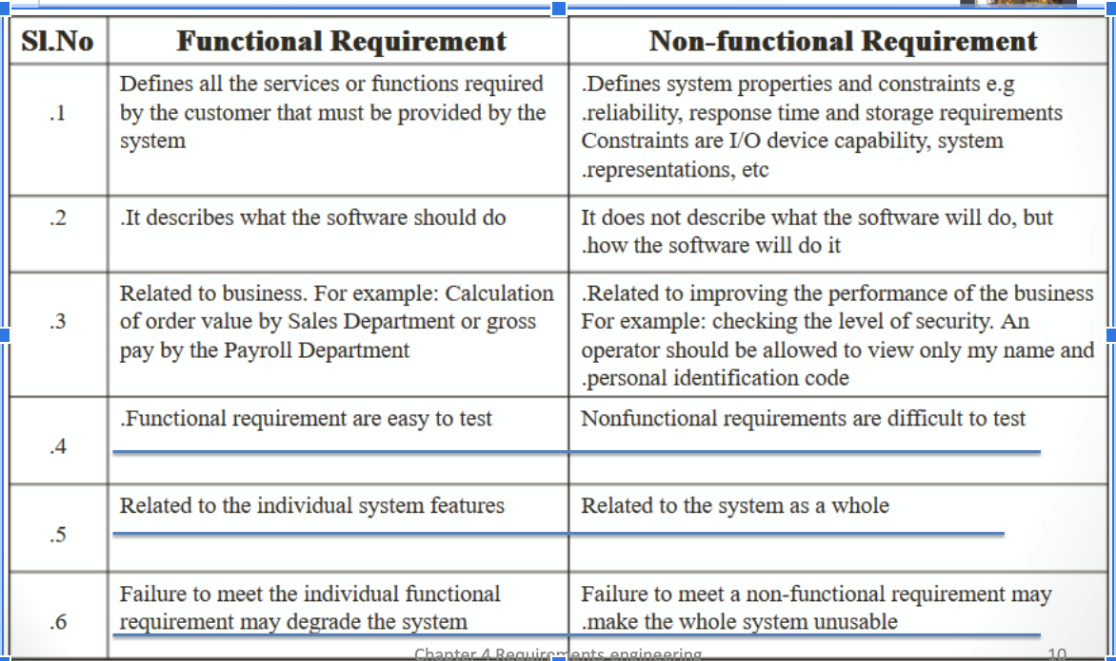
Functional and non-functional requirements

Slide 11
Non-functional requirements
These define system properties and constraints e.g.reliability, response time and storage requirements.
Constraints are I/O device capability, system representations, etc.
Process requirements may also be specified mandating a particular IDE, programming language or development method.
Non-functional requirements may be more critical than functional requirements. If these are not met, the system may be useless.

Slide 12
Non-functional classifications
Product requirements
Requirements which specify that the delivered product must behave in a particular way e.g. execution speed, reliability, etc.
Organisational requirements
Requirements which are a consequence of organisational policies and procedures e.g. process standards used, implementation requirements, etc.
External requirements:
Requirements which arise from factors which are external to the system and its development process e.g. interoperability requirements, legislative requirements, etc.

Slide 13
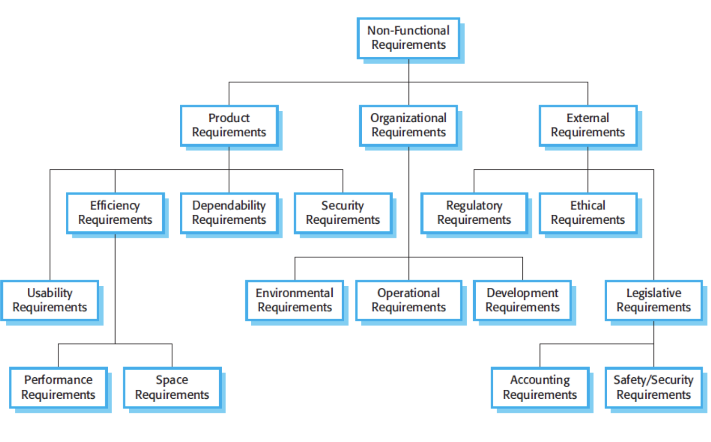
Non-functional requirements

Slide 14
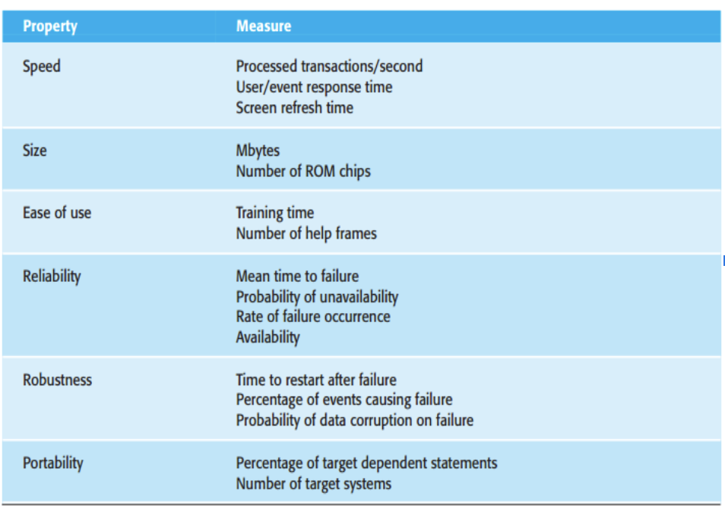

Metrics for specifying non-functional requirements

Slide 15
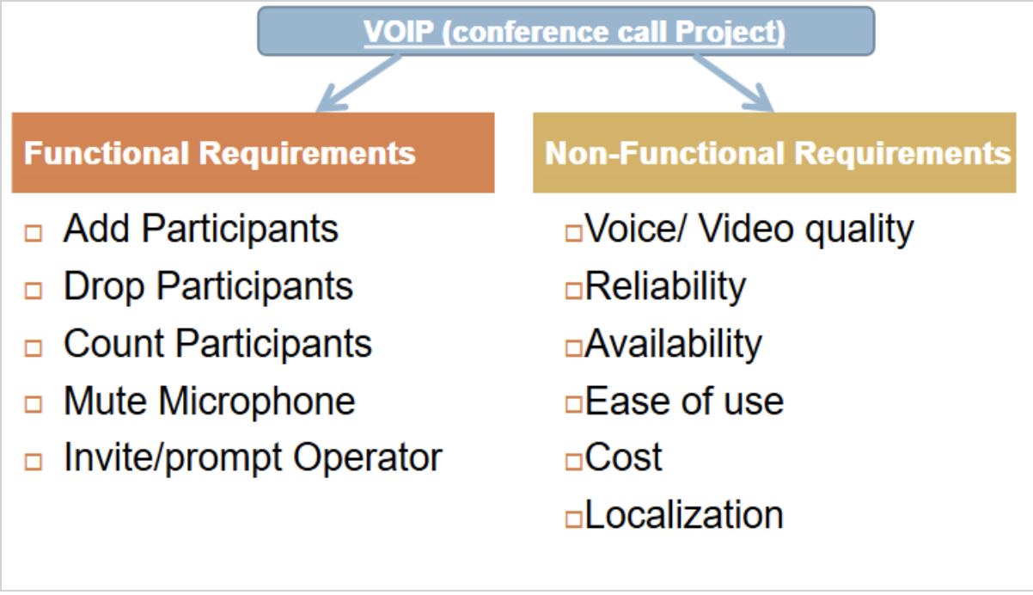
Another Example Functional and non-functional

Slide 16

Requirements engineering processes
The processes used for RE vary widely depending on the application domain, the people involved and the organisation developing the requirements.
However, there are a number of generic activities common to all processes
Requirements elicitation;
Requirements analysis;
Requirements validation;
Requirements management.

Slide 17
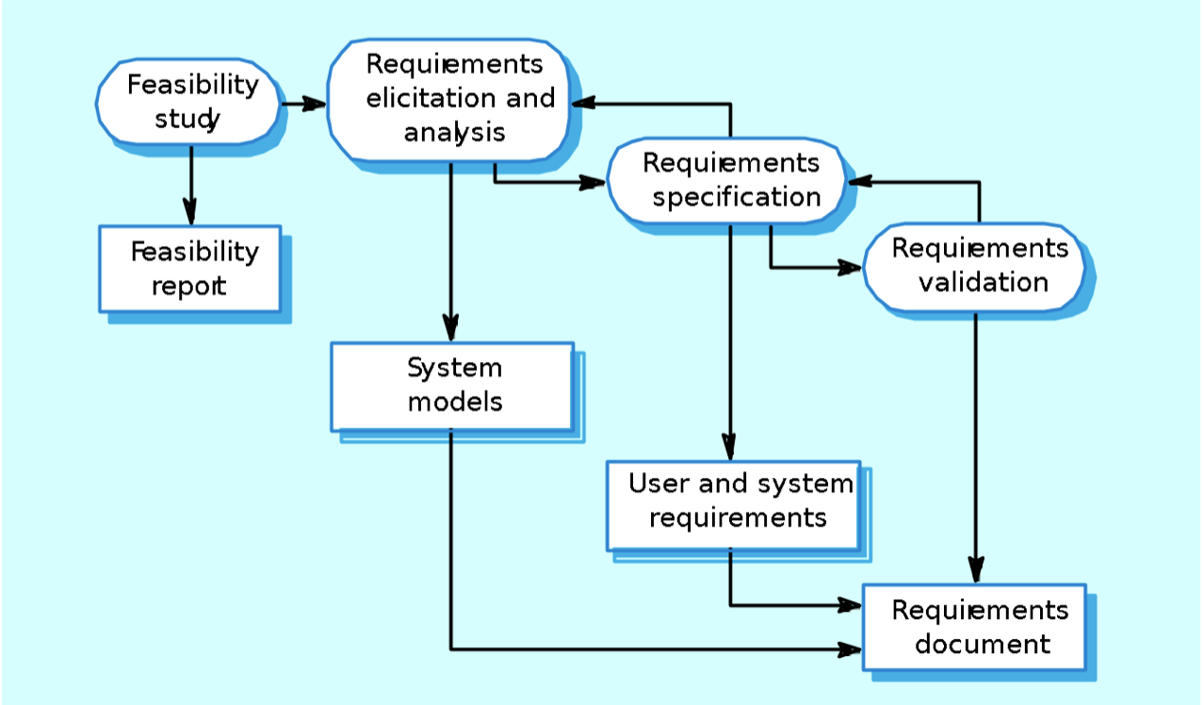
Requirement Engineering process

Slide 18

Feasibility studies
A feasibility study decides whether or not the proposed system is worthwhile.
A short focused study that checks
If the system contributes to organisational objectives;
If the system can be engineered using current technology and within budget;
If the system can be integrated with other systems that are already used.
Based on information assessment (what is required),information collection and report writing.

Slide 19

Requirements engineering: Elicitation and analysis
This is sometimes called requirements elicitation or requirements discovery.
It involves technical staff working with customers to find out about the application domain, the services that the system should provide and the system’s operational constraints.
May involve all stakeholders including end users

Slide 20
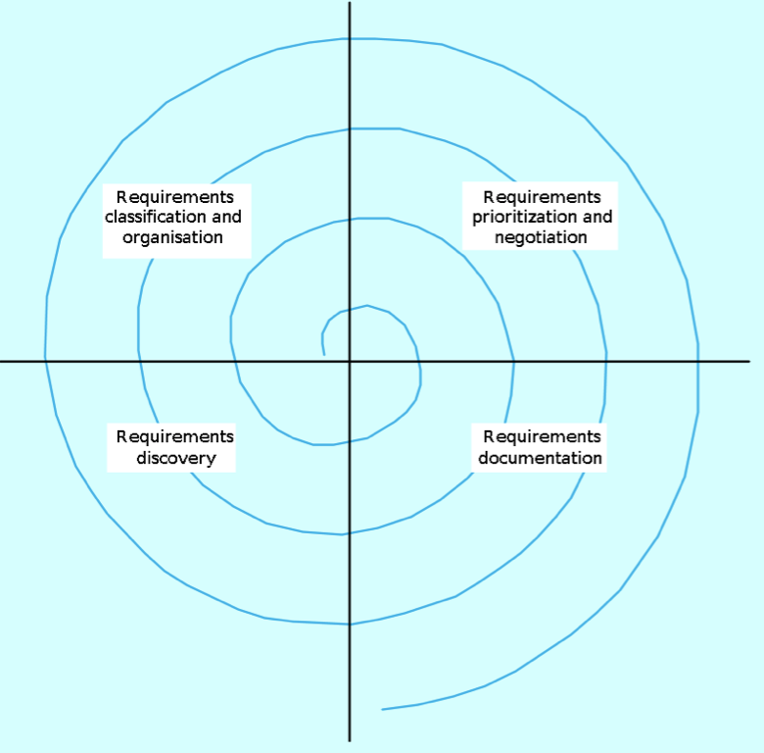
Requirements engineering:Process
Requirements discovery
Interacting with stakeholders to discover their requirements. Domain requirements are also discovered at this stage.
Requirements classification and organisation
Groups related requirements and organises them into coherent clusters.
Prioritisation and negotiation
Prioritising requirements and resolving requirements.
Requirements documentation
Requirements are documented and input into the next round of the spiral..

Slide 21
Requirements Discovery
There are several ways to do requirements discovery
Viewpoints
One of them is viewpoint where you place yourself as different stake holders and find requirements
So Viewpoints are a way of structuring the requirements to represent the perspectives of different stakeholders.
Interview
In formal or informal interviewing, the RE team puts questions to stakeholders about the system that they use and the system to be developed. There are two types of interview
Closed interviews where a pre-defined set of questions are answered.
Open interviews where there is no pre-defined agenda and a range of issues are explored with stakeholders.

Slide 22
Requirements Discovery
Scenario and Use Case
People usually find it easier to relate to real-life examples than to abstract description.
Scenario base requirement discovery helps us to do it.
We will cover this topic further on our Use Case lectures

Slide 23
Requirement Validation
We need to validate our requirements
Checks required during the requirements validation process.
Validity checks: Does the system provide the functions which best support the customer’s needs? ( Other functions maybe identified by a further analysis )
Consistency checks: Are there any requirements conflicts?
Completeness checks: Are all the requirements needed to define all functions required by the customer sufficiently specified?
Realism checks: Can the requirements be implemented given available budget, technology and schedule?
Verifiability: Can the requirements be checked?

Slide 24
Requirements validation techniques
Requirements reviews
Prototyping
Test-case generation

Slide 25
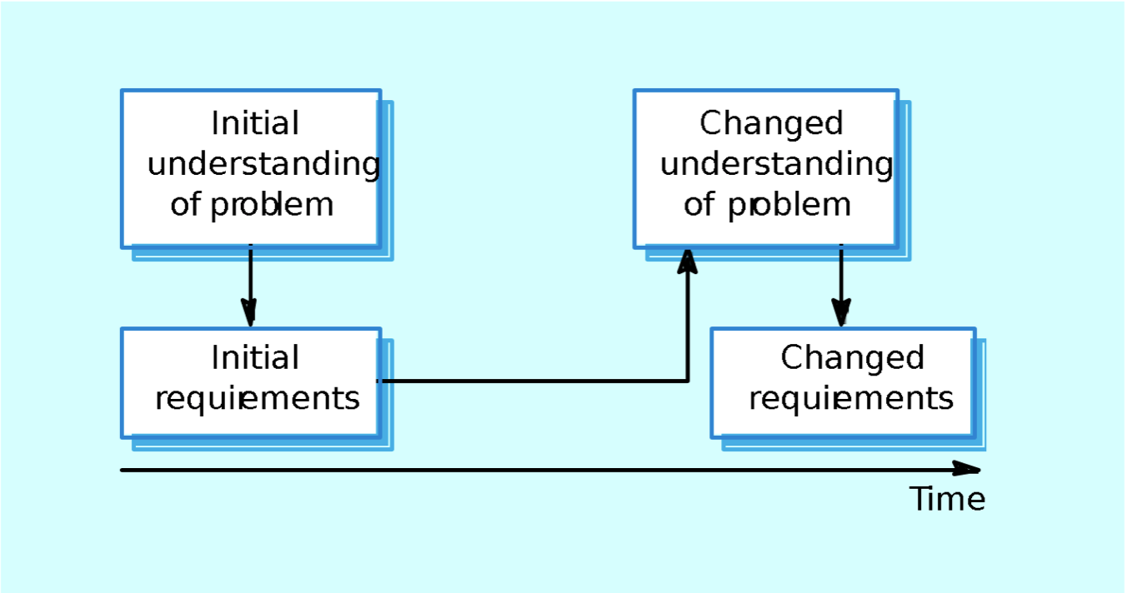
Requirements management
The requirements for large systems are frequently changing.
In fact, during the software process, the stakeholders’ understanding of the problem is constantly changing.
Requirements management is the process of managing changing requirements during the requirements engineering process and system development.

Slide 26
Enduring and volatile requirements
From an evolution perspective, requirements fall into two classes:
Enduring requirements.
Stable requirements derived from the core activity of the customer organisation and related directly to the domain of the system.
E.g., In a hospital, requirements will always relate to doctors, nurses,etc.
These requirements may be derived from a domain conceptual models that show entities and relations between them.
Volatile requirements.
Requirements which change during development or when the system is in use.
E.g., In a hospital, requirements derived from healthcare policy;

Slide 27

Key points
The requirements engineering process includes a feasibility study, requirements elicitation and analysis, requirements specification and requirements management.
Requirements elicitation and analysis is iterative involving domain understanding, requirements collection, classification, structuring, prioritisation and validation.
Systems have multiple stakeholders with different requirements.Business changes inevitably lead to changing requirements.
Requirements management includes planning and change management.
Requirements validation is concerned with checks for validity, consistency, completeness, realism and verifiability.

